Slide 1

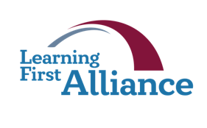

Lesson 7:
A Call to Action for Teachers
Transforming Teaching:
The Elements
Professional Learning Series
Developed by Stephanie Hirsh
This project is funded by the
Carnegie Corporation of New York.
Download a copy of the report:
www.Carnegie.org/Elements

Slide 2


Lesson 7:
A Call to Action for Teachers
This lesson focuses on the roles and responsibilities of key actors responsible for successful curriculum-based professional learning. We look closely at the roles and responsibilities of teachers. And we survey those for other actors in the system to highlight the interdependence of the work.
We also visit some assumptions and beliefs associated with this emerging field and invite you
to consider where yours are today as a result of
this learning opportunity. We hope this culminating lesson inspires and guides you in charting your
own path toward transformative teaching through curriculum-based professional learning.
In Lesson 7, like all others, you may follow the guidance for learning individually or with members
of your learning team; instructions for both are included in protocols. As always, the Learning Journal offers spaces for completing the protocols.

Slide 3
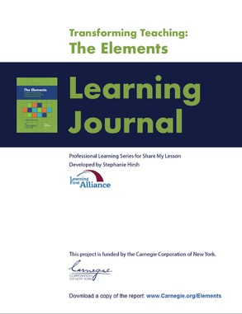

Lesson 7:
A Call to Action for Teachers
Participants will:
Learn about the roles and responsibilities for teachers and others that contribute to effective curriculum-based professional learning.
Examine assumptions and beliefs associated with curriculum-based professional learning.
Draft an action plan based on new learning and experiences.
To complete lesson protocols
see pp. 30–36 in the Learning Journal.
Individuals
30 min.
•
Teams
45–60 min.
Recommended time for Lesson 7

Slide 4
The Elements

Slide 5

Protocol
7.1
Where Are You Now?
Journal Writing
Refer to Protocol 7.1 in the Learning Journal (p. 30).
Reflect on these statements:
I am interested in learning more about the roles and responsibilities required for effective curriculum-based professional learning.
I am wondering how well my system’s current role expectations align with the recommendations.
I am open to rethinking priorities for myself and others responsible for successful curriculum implementation.
I am committed to identifying future professional learning priorities based on rethinking roles and responsibilities.

Slide 6

Protocol
2.1
A Call to Action
These won’t be quick fixes. Rigorous, standards-aligned teaching and learning require teachers to make fundamental shifts in habits, skills, knowledge, and beliefs. They require substantial changes in instructional culture and priorities.
We offer the Elements as both a guide and a call to action.

Slide 7

Protocol
7.2
Recommendations for Teachers
Examining Your Practice
Refer to Protocol 7.2 in the Learning Journal (pp. 31–32).
Study the next four slides — Recommendations for Teachers — that address roles and responsibilities for each of the design features and essentials.
Rate your current practice according to the scales in your Learning Journal.
Learning teams: Discuss your observations.
Draft three priorities for your future.

Slide 8



Recommendations for Teachers:
Core Elements
Develop deep expertise in your teaching content, the curriculum, and instructional materials you use with students.
Assess and clarify beliefs and assumptions about teaching, learning, curriculum, and students on an ongoing basis.
Maintain high expectations for students and commit to learning new ways to scaffold instruction.
Learn about students’ communities, cultures, racial and ethnic backgrounds, strengths, and interests. Use that understanding to employ culturally responsive teaching strategies.
Base opinions and value of curriculum on use and results with students.

Slide 9



Recommendations for Teachers:
Structural Elements
Review the research on collaborative learning structures and their implications for curriculum implementation with colleagues.
Hold yourself and others accountable for meaningful participation in collaborative learning.
Seek internal and external expertise and support to advance individual and group learning.
Document how time spent on curriculum-based professional learning makes an impact on your practice and students.
Communicate with parents and other stakeholders about the value of curriculum-based professional learning.

Slide 10




Recommendations for Teachers:
Functional Elements
Step away from the teacher role and commit to learning opportunities
that ask you to wear a “student hat.”
Accept that discomfort is a necessary part of the learning process.
Develop a habit of daily journaling or engage in other forms of reflective practice to promote personal growth.
Seek feedback and support from peers, coaches, and supervisors throughout the curriculum implementation process.
Contribute to and use change management tools, including Innovation Configuration maps, to guide improvement efforts.

Slide 11



Recommendations for Teachers:
Essentials Elements
Contribute to and champion a vision for teaching and learning
supported by curriculum-based professional learning.
Be able to explain curricular coherence that transcends grade levels
or courses.
Limit supplementary materials to those that are clearly aligned with
the vision for teaching and learning and core curriculum.
Be advocates and good stewards of professional learning time and resources; hold peers and facilitators to the same standards.
Act as an advocate for professional learning grounded in district curriculum and instructional materials.

Slide 12

Protocol
7.3
Recommendations for Others
Examining Others’ Practice
Refer to Protocol 7.3 in the Learning Journal (p. 33).
Study the next two slides that address roles and responsibilities for others in school systems.
Based on your perspective and experience address the questions in the Learning Journal.
Learning teams: Discuss your observations.

Slide 13
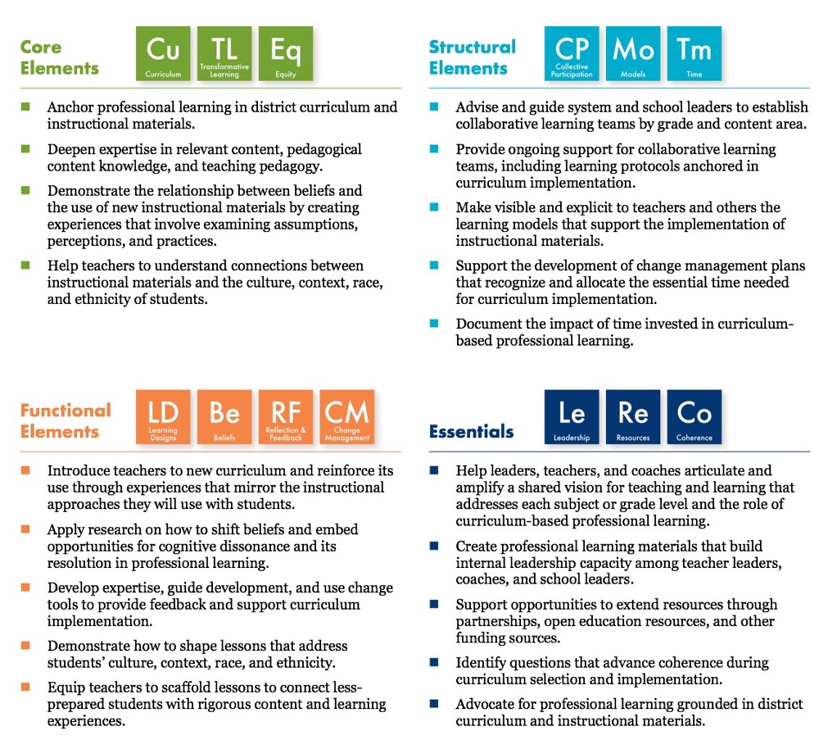
Recommendations
Professional Learning
Providers and Coaches

Slide 14
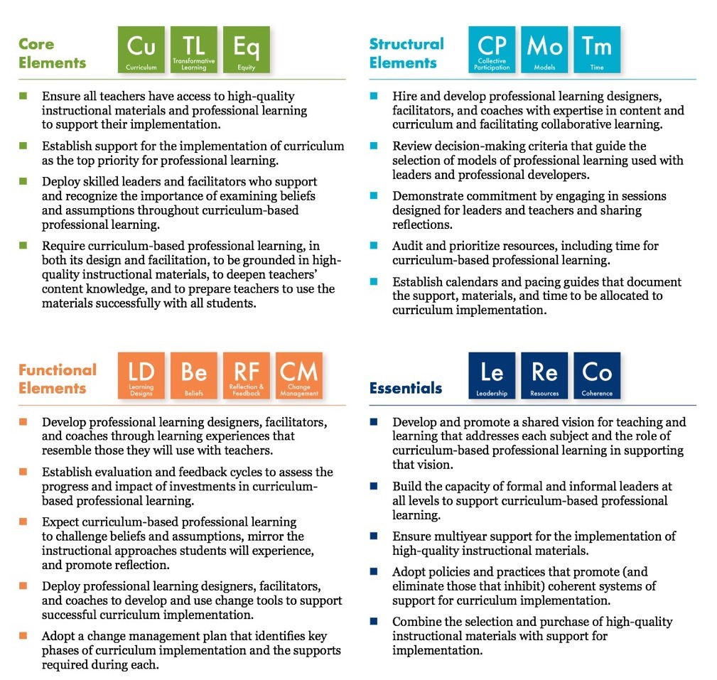
Recommendations
System and
School Leaders
The Elements of Curriculum-Based Professional Learning
Learn more at www.carnegie.org/elements

Slide 15

Protocol
7.4
Where Do We Go From Here?
Examining Beliefs and Assumptions
Refer to Protocol 7.4 in the Learning Journal (pp. 33–35).
Read the explanations offered for beliefs and assumptions on the next slide and consider the
important role they play in this work.
Read the beliefs and assumptions associated with the field of curriculum-based professional learning that follow and rate yourself in the Learning Journal.
Consider the degree to which your beliefs and assumptions shifted during these lessons and
potential implications for your work ahead.
Learning teams: Discuss your observations.

Slide 16
Protocol
2.1
Beliefs and Assumptions
Beliefs are what we hold to
be true. They endure over time. They drive what we say, think, and do. Beliefs can be the source of deep conflict and strong alliances among people.
— Hirsh and Killion, 2007
Assumptions are the logic behind our beliefs and signal the reasons for those beliefs. Assumptions guide how we behave, what we plan, and what we execute. They provide the rationale for our intended outcomes, our best-laid plans, and our expectations for success.
— Hirsh, Psencik, and Brown, 2018

Slide 17
Protocol
2.1
Where Do You Stand?
Principals and teacher leaders have significant roles to play in the adoption and implementation of high-quality instructional materials.
School systems are responsible for ensuring that all teachers can
access high-quality instructional materials and effective, job-embedded professional learning.
High-quality instructional materials can be implemented successfully without ongoing professional learning.
Focusing professional learning communities (PLCs) on implementing high-quality curriculum and instructional materials builds collective responsibility and accelerates progress for all students.

Slide 18
Protocol
2.1
Where Do You Stand?
Educative curriculum materials guide teachers to adapt lessons to address students’ cultures, interests, and needs.
Most teachers believe their responsibility is to develop lessons
from scratch.
Professional learning anchored in the instructional materials teachers use with students will enhance teaching.
Ensuring all teachers have access to high-quality instructional materials is one of today’s most important equity issue.

Slide 19
Protocol
7.5
Let’s Get Started
Planning and Reflection
Refer to Protocol 7.5 in the Learning Journal (p. 36).
Respond to the prompts below in your Learning Journal and report what you are comfortable sharing with your learning team.
What are the small and big “moves” you will take next?
What results do you hope to achieve as a result of these actions?
How will you make yourself accountable for following through on your commitments?
With whom will you share your findings?
What were the most significant take-aways from these lessons?
What did you want or need that you did not have during these lessons?
What would you appreciate receiving next?
How will you stay in touch with developments in the field?
Start by sharing Protocol 7.5 with us at info@learningfirst.org.

Slide 20


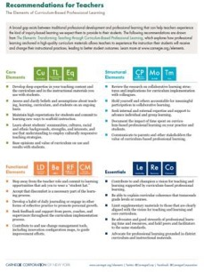
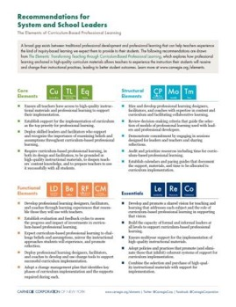
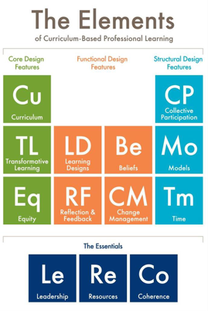
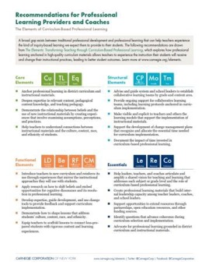
Protocol
2.1
For more Elements resources visit
www.Carnegie.org/Elements
At CurriculumPD.org
you’ll find:
The Elements Report
Elements Animation
Tools
Case Studies

Slide 21
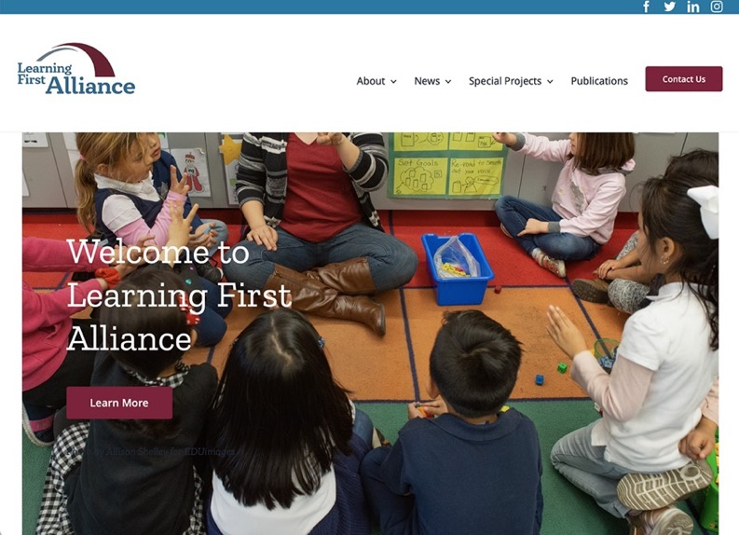
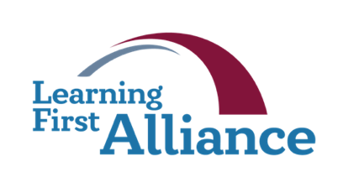
Protocol
2.1
Learning First Alliance
www.LearningFirst.org
The Learning First Alliance is a partnership of leading education organizations representing more than 10 million members dedicated to improving student learning in America’s public schools. We share examples of success, encourage collaboration at every level, and work toward the continual and long-term improvement of public education based on solid research.
Twitter: @LearningFirst
Facebook: Learning First Alliance

Slide 22
Protocol
2.1
Let’s Stay in Touch
Contact Stephanie Hirsh at
Stephanie.Hirsh@gmail.com
Follow Stephanie on
Twitter: @HirshLF
Follow developments in the field at:
LearningFirst.org
CurriculumPD.org
Carnegie.org/Elements
CurriculumHQ.org
EdReports.org
LearningForward.org
Best wishes for continued success along your learning journey.
Photo credits for Slides 2, 6, 7, 12, and 15: Allison Shelley for EDUimages.

