Slide 1
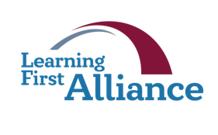
Lesson 6:
Essential Elements
Transforming Teaching: The Elements
Professional Learning Series
Developed by Stephanie Hirsh
This project is funded by the Carnegie Corporation of New York.
Download a copy of the report:
www.Carnegie.org/Elements

Slide 2
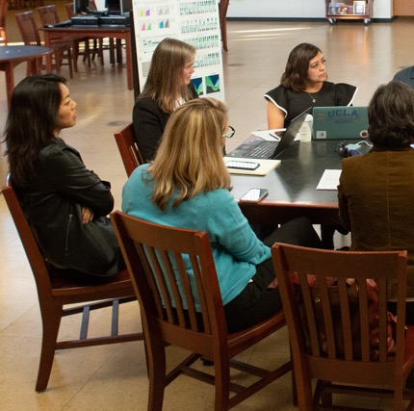
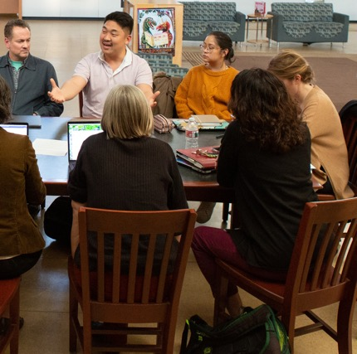
Lesson 6:
Essential Elements
This lesson focuses on three Elements we refer to as the Essentials — the necessary conditions at the system level for curriculum-based professional learning. These enabling conditions define define specific expectations of system leaders, principals and teachers for implementing curriculum-based professional learning.
Each helps to build and sustain learning organizations, where ongoing investments in high-quality instructional materials and support for their implementation contribute to a powerful vision for instruction and success for all students.
In this lesson, like all others, you may follow the guidance for learning individually or with members of your Learning Team. There are instructions for both included in protocols. As always, the Learning Journal will offer you spaces for completing the protocols.

Slide 3
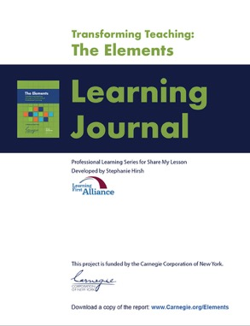
Lesson 6:
Essential Elements
Participants will:
Gain understanding of the essential Elements.
Consider implications of the essential Elements in action for their work.
Identify areas for further exploration.
To complete lesson protocols see pp. 27–29 in the Learning Journal.
Individuals
30 min.
•
Teams
45–60 min.
Recommended time for Lesson 6

Slide 4
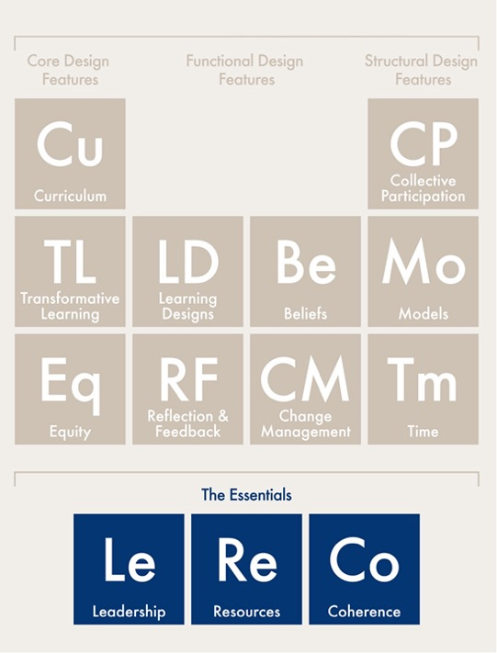
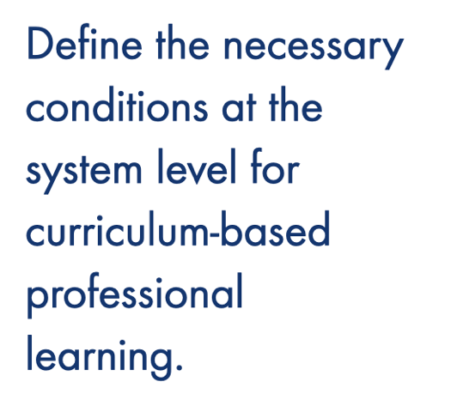
Essential Design Features

Slide 5
Protocol
6.1
Where are you now?
Journal Writing
Refer to Protocol 6.1 in the Learning Journal (p. 27).
Reflect on these statements:
I am interested in learning more about the enabling conditions for curriculum-based professional learning…
I am wondering if these conditions are supported by the system and school leaders in my own context…
I am looking for ways to help build learning organizations that invest in high-quality instructional materials and support their implementation through curriculum-based professional learning…
I am committed to helping system leaders and principals support teachers, contribute to a powerful vision for instruction, and enable the success of all students…

Slide 6
Protocol
2.1
Essential Enabling Conditions
Leadership: Commits district, school, and teacher leaders to a shared vision for learning and instruction that applies to both students and adults, creates a culture of respect, and supports necessary risk-taking for curriculum implementation.
Resources: Ensures that schools have adequate time, funding, access to experts, high-quality standards-aligned instructional materials, and assessments, along with the professional learning materials needed for sustainable implementation.
Coherence: Aligns system and school policies, priorities, practices, and curriculum to a shared vision of learning and teaching.

Slide 7
Protocol
6.2
Recognizing Essential Elements in Practice
Learning from Charlotte-Mecklenburg Schools
Refer to Protocol 6.2 in the Learning Journal (p. 28).
Brian Kingsley is the Chief Academic Officer at Charlotte-Mecklenburg Schools in North Carolina. Listen while Brian discusses professional learning and how it benefits the teachers and students.
While listening, record examples of “The Essential Elements” in action.
Following the audio, record wonderings and questions.
Share your findings with your learning team members.

Slide 8
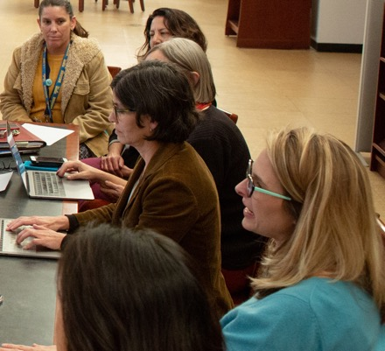
Protocol
6.3
Putting Essential Elements to Work
Examining Your Practice
Refer to Protocol 6.3 in the Learning Journal (p. 28).
Study the next three slides:
Putting Leadership to Work
Putting Resources to Work
Putting Coherence to Work
Record in your Learning Journal actions that are currently part of your own work and opportunities for expanding them.
Learning teams: Discuss your observations.

Slide 9
Putting Leadership to Work
Leaders are learners | Knowledge is constructed | A shared vision
Leaders don’t have all the answers; rather, they are continuously learning alongside their colleagues and teachers. They model learning activities such as listening, questioning, and reflecting with colleagues, and their decisions prioritize support for teacher learning. | The process of learning is ongoing, as leaders and other adults build institutional and individual knowledge together. Leaders facilitate and listen as others share past and current practices. They build trusting relationships that support honest, forward-looking reflection. These conversations create shared meanings and new habits and beliefs. | Rooted in shared ideas and understanding, leadership transcends individual titles or roles. Through reflection, listening, study, and collaborative goal setting, teachers, coaches, and principals build a vision that guides professional learning and daily decisions.

Slide 10
Putting Resources to Work
Honest accounting | Ongoing commitment | Audit for expertise
Curriculum-based professional learning takes considerable time, money, and effort. For effective professional learning to occur, those essential resources must be oriented toward a shared vision of curriculum and instructional improvement. Leaders must be clear with all about the extent of the resources required. They may need to make tough decisions about what to prioritize and what to put on the back burner. They also clearly document the return on these investments in terms of student progress. | Resources needed to support curriculum-based professional learning will fluctuate over time. Different resources are needed during curriculum launch and ongoing implementation, but the need for resources will never disappear. New teachers will need in-depth professional learning; veteran staff members will benefit from booster shots of professional learning as well as frequent opportunities for practice, data review, and refinement. These investments are integrated and ongoing. | Investments of time and money are investments in expertise, whether homegrown or external. Districts take stock of available expertise in curriculum-based professional learning over time. Which teacher leaders are prepared to facilitate learning experiences? What resources are needed to build and maintain connections to external experts, such as curriculum developers, professional learning designers and facilitators, and researchers at local colleges and universities? Maintaining talent pipelines and external relationships provides another important resource.

Slide 11
Putting Coherence to Work
Share the vision | Ask why and how | Go step by step
Coherent schools have a compelling vision and mission, which is evident in leaders’ decisions, communications, and actions, and creates a common language for all school professionals. Explicit connections among a school’s vision, language, and actions can sharpen decision-making and illustrate the coherence that knits a learning organization together. | Successful schools prioritize strategies that promote curriculum-based professional learning and put them into action. In choosing among competing priorities, leaders select those that complement existing efforts and promote further success. They take specific steps toward coherence rather than adopt policies that are abstractly connected. They always work to clarify focus, cultivate collaborative cultures, secure accountability, and deepen learning. | Coherent curriculum-based professional learning helps teachers understand the structures underlying high-quality instructional materials. It guides teachers along a path to mastery, building their expertise through successive experiences and reflection opportunities. Less coherent schools take a scattershot approach, solving problems as they occur. While professional learning can be responsive to teachers’ evolving needs, its general trajectory should conform to a learning progression grounded in the curriculum.

Slide 12
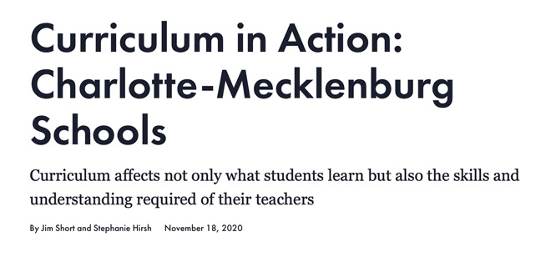
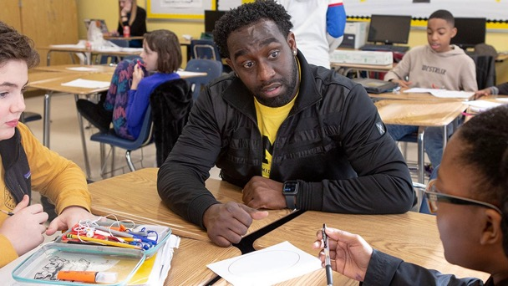
Protocol
6.4
Essential Elements in Action
Case Study Discussion
Refer to Protocol 6.4 in the Learning Journal (p. 29).
Read the story about Charlotte-Mecklenburg Schools that elaborates on what you heard earlier in this session.
Use your new knowledge regarding the Essential Elements to identify examples of each in action.
Record those examples in your Learning Journal.
Share your findings with your learning team.

Slide 13
Protocol
6.5
Final Reflections
Reflective Writing
Refer to Protocol 6.5 in the Learning Journal (p. 29).
Respond individually in your Learning Journal and share what you are comfortable with your learning team.
What more do you want to learn to put the Essentials into action?
How do the Essentials create the enabling conditions for curriculum-based professional learning?
What are critical connections among the Essentials that enable successful professional learning?
What next actions will you pursue?

Slide 14
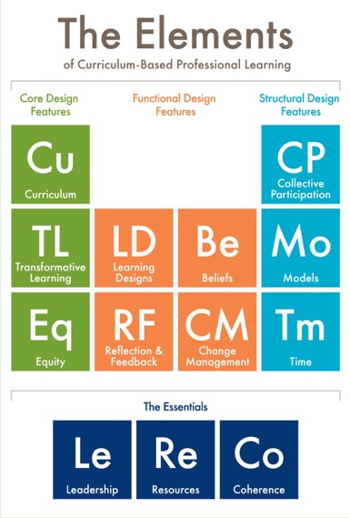
Protocol
2.1
What’s Next?
Post session — Read to reinforce: The Elements: Transforming Teaching and Curriculum-based Professional Learning (pp. 45–54)
Lesson 7 — Read to prepare: A Call to Action for Teachers (pp. 55–59)

Slide 15
Protocol
2.1
Additional Resources
Additional Resources
Learning First Alliance Podcast 3: A Deep Dive into The Elements
Learning Forward Report: The Path to Instructional Excellence and Equitable Outcomes: D.C.’s LEAP program helps teachers become experts at teaching high-quality, standards-aligned content so that every student experiences rigorous and engaging instruction every day
Learning Forward Report: High-quality Curricula and Team-based Professional Learning: A Perfect Partnership for Equity (3 case studies)
Photo credits, for slides 2 and 8: Allison Shelley for EDUimages.

