Slide 1



Lesson 5:
Functional Elements
Transforming Teaching:
The Elements
Professional Learning Series
Developed by Stephanie Hirsh
This project is funded by the
Carnegie Corporation of New York.
Download a copy of the report:
www.Carnegie.org/Elements

Slide 2


Lesson 5:
Functional Elements
Effectively designed curriculum-based teacher professional learning incorporates the same lessons in the instructional materials used with students. Rooted in sequenced learning experiences that
focus on teachers’ underlying beliefs, this professional learning progressively deepens
teacher understanding and promotes enduring changes in their practices.
In this lesson, we explore the four functional
design Elements that inform how curriculum-based professional learning works when designed and implemented. Taken together, these Elements link curriculum with changes in teachers’ classroom practices to accelerate learning for all students.
In Lesson 5, like all others, you may follow
the guidance for learning individually or with members of your learning team. Instructions for both are included in protocols. As always, the Learning Journal offers space for completing
the protocols.

Slide 3
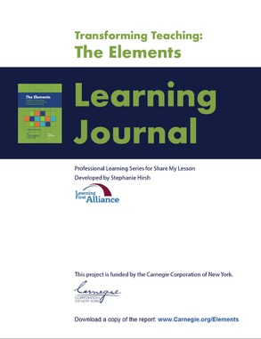

Lesson 5:
Functional Elements
Participants will:
Gain understanding of the functional design features.
Consider implications of the functional Elements in action for their work.
Identify areas for further exploration.
To complete lesson protocols
see pp. 23–26 in the Learning Journal.
Individuals
30 min.
•
Teams
45–60 min.
Recommended time for Lesson 5

Slide 4
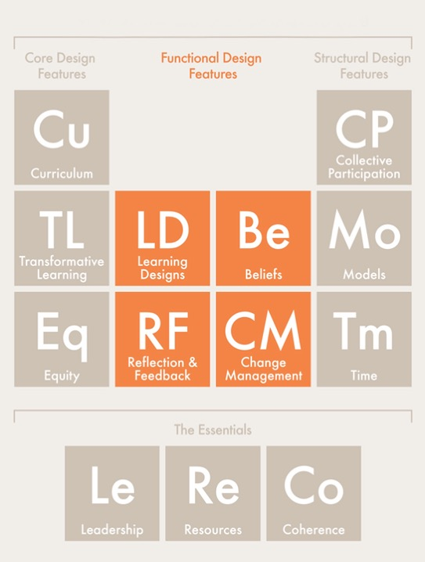
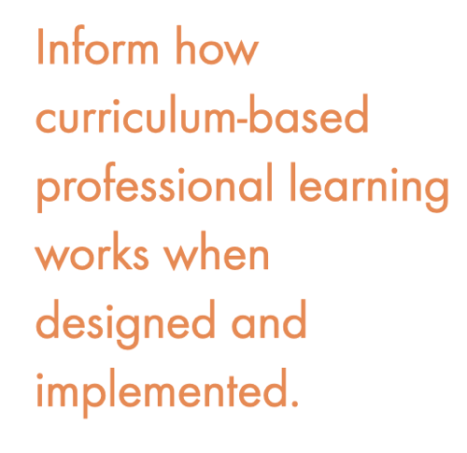
Functional Design Features

Slide 5

Protocol
5.1
Where Are You Now?
Journal Writing
Refer to Protocol 5.1 in the Learning Journal (p. 23).
Reflect on these statements:
I am interested in learning more about what distinguishes the functional design features…
I am wondering how much of my current professional learning focuses on the functional Elements…
I am open to rethinking how to apply the functional design features to strengthen my professional learning...
I am committed to professional learning that benefits both educators and students...

Slide 6




Protocol
2.1
Functional Design Features
Learning Designs: Engage teachers as learners through inquiry and sense-making while using the same instructional materials their students will use.
Beliefs: Address teachers’ ideas and assumptions about how to teach specific content, how students learn the same content, and how high-quality instructional materials provide productive ways to support student learning.
Reflection and Feedback: Calls for facilitated time when teachers think about
new instructional materials, receive input on how best to use them, examine student work and assessment data, and make changes to instructional practice
in response.
Change Management: Addresses teachers’ individual concerns and group challenges when implementing new instructional materials, including explicit opportunities to discuss and troubleshoot issues.

Slide 7
Protocol
5.2
Understanding Functional Elements
Digging Deeper
Refer to Protocol 5.2 in the Learning Journal (p. 24).
Read, study, and listen to the explanations and examples of the four functional design elements on Slides 8–14:
Putting Learning Designs to Work/How you engage as “Learner”
Putting Beliefs to Work/When do beliefs change?
Putting Reflection and Feedback to Work
Putting Change Mangement to Work
In your Learning Journal record key points to remember.
Discuss your findings with your learning team.

Slide 8
Putting Learning Designs to Work
Shift teachers’ perspectives | A mirror image | Build homegrown expertise
Rather than tell teachers about a curriculum, let them experience it for themselves. Putting on a student hat can help teachers trust that student-led discussions can be productive and anticipate questions and ideas that will likely surface. | Teachers should engage in the same inquiry and reflection that they will engage with their students. In curriculum-based professional learning, teacher learning is the focus and the goal, so each activity engages teachers in discussion and reflection about what contributed to their development. | Curriculum-based professional learning extends past the launch of a new curriculum. Veteran teachers continue to implement the learning designs introduced in orientation sessions and support each other in preparing to teach future units and lessons. As new teachers are hired, they too will need support to understand how to use the school’s curriculum. Schools and districts will benefit from investing in teacher leaders and other instructional leaders to provide immersive learning opportunities and ongoing coaching.

Slide 9




How do you engage as a “Learner”?
Sometimes you’ll wear your student hat…
Lesson
Activity
and sometimes you’ll wear your teacher hat.
Student
Lens
Session
Introduction
Session
Reflection
Teacher
Lenses

Slide 10
Putting Beliefs to Work
Rock the boat | Reflect and resolve | Seek clarity
To kick-start new ideas, give teachers evidence of what works and ask them what they think about it. A disruptive learning experience, such as putting on a student hat during a model lesson or seeing a lesson taught in an authentic setting, can launch a conversation on teachers’ assumptions about instruction. | Reflection should be part of teachers’ cycle of learning and rooted in their experiences. Channeling teachers’ discoveries and discomfort into new practices and beliefs is a critical aspect of curriculum-based professional learning. Teachers need ongoing, job-embedded opportunities to work with their colleagues; resolve cognitive dissonance; and discuss, update, and clarify their thinking. | Discussions or reflections about beliefs often start with general statements of values, such as “All kids can learn.” But they must go deeper. Individual teachers have built their belief systems over time, and they won’t all need the same type of disruptive experience to prompt change. Learning experiences should be tailored to schools and teachers. Efforts to make meaning and resolve cognitive dissonance should be connected to teachers’ own students. Facilitated conversations and well-chosen writing exercises can prompt teachers to think critically about their practices and students’ experiences.

Slide 11
When do beliefs change?
Which order is based on the research about teacher change?
A. Shift beliefs —> change practice —> students learn
B. Shift beliefs —> students learn —> change practice
C. Change practice —> students learn —> shift beliefs
D. Change practice —> shift beliefs —> students learn

Slide 12

Correct answer according to research:
C. Change practice —> students learn —> shift beliefs
Kate McNeill is a professor in science education at Boston College and director of designing the OpenSciEd professional learning approach to support the implementation of the curriculum. Listen while Kate talks about how the OpenSciEd approach to professional learning is different than traditional professional development training teachers to use new curriculum materials, watching for the impact on students and how this approach leads to shifting beliefs.
“So, engaging in that kind of student hat encourages teachers to take a step back and think, don't think like an adult teacher. Try to think like one of your kids. Put yourself in the mindset of one of your kids and how might they experience this lesson, where might they want to go. And doing that can help them—the teachers—think differently about the unit and better support their kids when it comes to actually enacting it in their classrooms.”
— Katherine McNeill

Slide 13
Putting Reflection and Feedback to Work
Build trust | A broad look for evidence | Observe and reflect together
Effective feedback lays the groundwork for teachers to recognize their strengths and weaknesses and commit to ongoing improvement. Teachers’ confidence in observers, peers, instructional materials, and the processes they use affects the degree to which they embrace feedback and reflection. Observations by peers and seeing others teach can provide a common, shared experience that supports building trust. | Feedback that leads to growth takes many forms. One type comes from coaches and peers. This feedback is bite-sized and grounded in shared definitions and metrics of success. Another type is based on how students engage with instruction. Are they participating, learning the material, and remaining connected to their classmates and the learning process? Neither type of feedback is used to evaluate performance; rather, both serve to describe progress, diagnose challenges, and create a roadmap to greater success. | In years past, teachers were left to their own devices and provided feedback only during performance evaluations. Curriculum-based professional learning is less hierarchical and more constructive in its feedback processes. At each stage of the learning cycle, teachers reflect individually and jointly on their instruction and the curriculum, in both facilitated conversations and responses to writing prompts. Observations and feedback other than formal performance evaluation are conducted by instructional leaders, coaches, and peers.

Slide 14
Putting Change Management to Work
A process, not an event | Support people | Stay the course
Change isn’t the difference between before and after; rather, it’s an ongoing disruption of thinking and doing. It requires adults to make and remake their knowledge, actions, and beliefs. And such remaking requires attention and energy over time. Enduring change happens over three to five years, not during a single launch period. | Change is disruptive. It requires adults to let go of old ways of doing things and recasts their experience and expertise as less relevant or in need of an update. Supporting curricular change means guiding teachers to come to grips with uncertainty. First-hand experience seeing how new curriculum materials benefit students focuses teachers on benefits of the new rather than loss of the old. | Dealing with change, adults often look to restore their equilibrium, often backsliding into old ways of thinking and doing. Ongoing reflection and feedback can help teachers remain connected to the process of change. These experiences are rooted in instructional coaching and facilitated, curriculum-based professional learning experiences that challenge teachers to review evidence on student learning and reexamine their beliefs.

Slide 15

Protocol
5.3
Putting Structural Elements to Work
Examining Your Practice
Refer to Protocol 5.3 in the Learning Journal (pp. 24–25).
Read the story about OpenSciEd Professional Learning, Open Source for Opening Minds.
Use your new knowledge regarding the four functional Elements to identify examples of
each in action.
Record those examples in your Learning Journal.
Share your findings with your Learning Team.
Challenge: identify and share examples of
other Elements.

Slide 16
Protocol
5.4
Putting Functional Elements to Work
Examining Your Practice
Refer to Protocol 5.4 in the Learning Journal (p. 25).
Respond individually in your Learning Journal and report what you are comfortable sharing with your learning team.
Record in your Learning Journal practices that are currently part of your own work and opportunities for expanding them.
Learning teams: Discuss your observations.

Slide 17
Protocol
5.5
Final Reflections
Reflective Writing
Refer to Protocol 5.5 in the Learning Journal (p. 26).
Respond individually in your Learning Journal and share what you are comfortable with your learning team.
What more do you want to learn to about functional Elements?
How do the functional Elements contribute to successful professional learning?
What are critical connections among the functional Elements?
What next actions will you pursue?

Slide 18
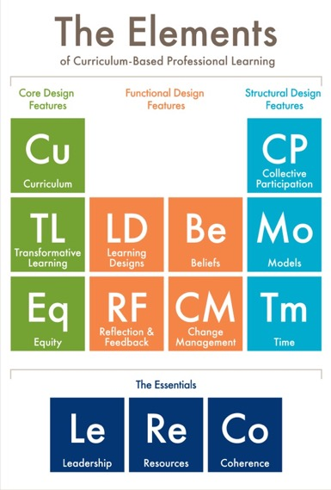



Protocol
2.1
What’s Next?
Post session —
Read to reinforce:
The Elements: Transforming Teaching and Curriculum-based Professional Learning
(pp. 23–35)
Lesson 6 —
Read to prepare: Essential Elements
(pp. 45–54)

Slide 19
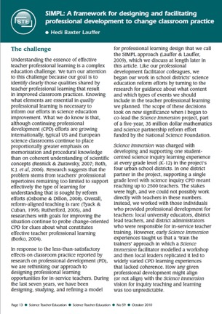
Protocol
2.1
Additional Resources
Learning First Alliance Podcast 3: A Deep Dive into The Elements Aspen Institute: Practice What You Teach The SIMPL Model: A research synthesis and a power point explanation. (See copies in the Learning Journal Folder.)
Photo credit for Slide 2: Allison Shelley for EDUimages.
Notes:
NOTE: WILL NEED LINK TO LEARNING JOURNAL FOLDER WHERE THE COPIES WILL BE FOUND

