Slide 1
Lesson 4:
Structural Elements
Transforming Teaching: The Elements
Professional Learning Series
Developed by Stephanie Hirsh
This project is funded by the Carnegie Corporation of New York.
Download a copy of the report:
www.Carnegie.org/Elements

Slide 2
Lesson 4:
Structural Elements
Professional learning can address many challenges and priorities that schools face. Curriculum- based professional learning is used specifically to support teachers in the application of high-quality instructional materials. Structural Elements describe the parameters and settings for curriculum-based professional learning. You recall that Core Elements represent the learning outcomes because they address the specific content and pedagogy that are the foci for study.
Structural Elements may also be applied to many purposes of professional learning; in this case, they are designed in a way to accelerate the impact of curriculum study.
In Lesson 4, like all others, you may follow guidance for learning individually or with members of your learning team; instructions for both are included in protocols. As always, the Learning Journal offers space for completing the protocols.

Slide 3
Lesson 4:
Structural Elements
Participants will:
Gain understanding of the structural design features.
Consider implications of the structural Elements in action for their work.
Identify areas for further exploration.
To complete lesson protocols see pp. 19–22 in the Learning Journal.
Individuals
30 min.
•
Teams
45–60 min.
Recommended time for Lesson 4

Slide 4
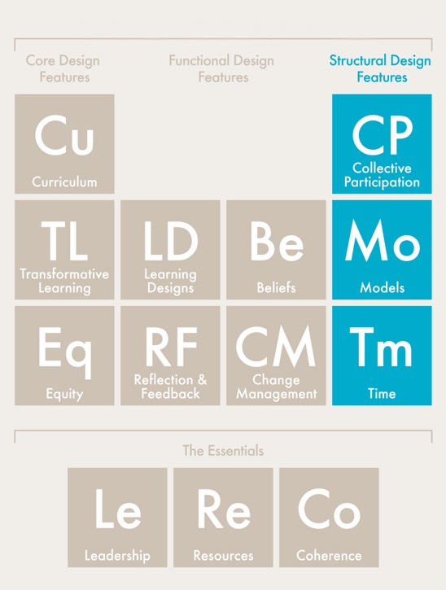
Structural Design Features

Slide 5
Protocol
4.1
Where are you now?
Journal Writing
Refer to Protocol 4.1 in the Learning Journal (p. 19).
Reflect on these statements:
I am interested in learning more about what distinguishes the structural design features…
I am wondering how much of my current professional learning focuses on the structural Elements…
I am open to rethinking how to apply the structural design features to strengthen my professional learning...
I am committed to professional learning that benefits both educators and students...

Slide 6
Protocol
2.1
Structural Design Features
Collective Participation: Builds on collaboration among teachers in the same school, grade, or department using the same instructional materials.
Models: Provides appropriate adult learning strategies, including coaching, expert support, study groups, professional learning communities, institutes, workshops, and learning walks to achieve intended outcomes.
Time: Enables teachers to learn, practice, implement, and reflect on the use of new instructional materials during the summer and throughout the school year.

Slide 7
Protocol
4.2
Recognizing Structural Elements
Analyzing a Video Case
Refer to Protocol 4.2 in the Learning Journal (p. 20).
1. Watch the Hollis Academy video and record examples for each structural Element. (See the previous slide.)
2. Following the video, record any wonderings and questions you have in the Learning Journal.
3. Learning teams: Take turns sharing examples for each Element.
4. Learning teams: Finish the session by sharing a wondering or question.
Play
video.

Slide 8
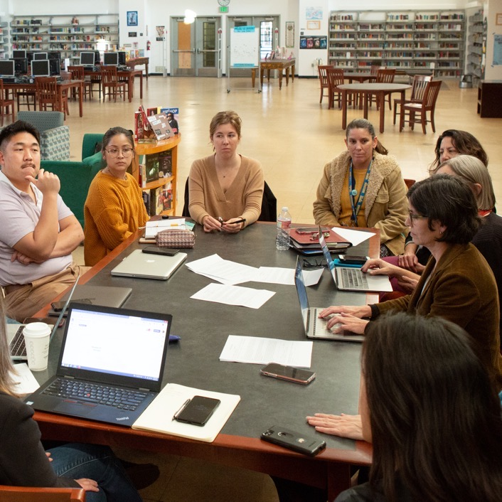
Protocol
4.3
Putting Structural Elements to Work
Examing Your Practice
Refer to Protocol 4.3 in the Learning Journal (pp. 20–21).
Study the next three slides:
Putting Collective Participation to Work
Putting Models to Work
Putting Time to Work
Record both practices that are routine in your own work and opportunities for expanding them in the Learning Journal.
Learning teams: Discuss your observations.

Slide 9
Putting Collective Participation to Work
More focus | More purposeful | More guidance
Save it for email — avoid agenda-driven planning periods or department meetings that focus on housekeeping. Establish curriculum study, practice, and reflection as the main subject of teacher and leader meetings, not an optional discussion item at the end. | Assemble professional learning community groups by grade level and subject. Establish curriculum implementation as the core agenda for their time together: reviewing student data, including work samples; planning and rehearsing lessons; or troubleshooting shared challenges. | Ensure that well-prepared facilitators are available for each professional learning community. Identify and support teacher leaders who can grow into these roles in future years.

Slide 10
Putting Models to Work
A tailored approach | Consistent effort | Looking forward
Professional learning is not one-size-fits-all. It should include a collection of research-based learning approaches that instructional leaders thoughtfully select based on the needs of individual teachers and professional learning communities at different stages of implementation. | Summer institutes are the beginning, not the end. Curriculum-based professional learning continues throughout the school year and takes different forms, including professional learning communities and instructional coaching. | Curriculum-based professional learning must be ongoing and sustainable, which means it cannot be led solely by outside experts. Schools and districts plan to build in-house expertise and leadership pipelines.

Slide 11
Putting Time to Work
Make a commitment | Get creative | Be intentional
Effective implementation of high-quality instructional materials must be a priority and drive decision making. Within a teacher’s schedule, allotting time to study, practice, and plan is essential for effective teaching, not merely nice to do. | District, school, and teacher leaders can find time for professional learning in unexpected ways, such as adjusting daily schedules, introducing late starts or early dismissals, or hiring floating substitutes. | It’s not about time itself, but how that time is used. In all professional learning sessions, teachers must engage with their instructional materials in a purposeful way, driven by goals in collaboration with colleagues and guided by a well-prepared instructional coach or facilitator.

Slide 12
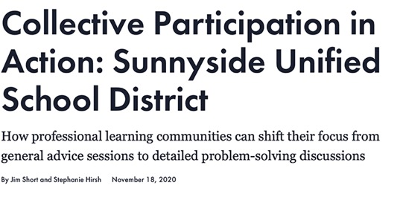
Protocol
4.4
Structural Elements in Action
Case Study Discussion
Refer to Protocol 4.4 in the Learning Journal (p. 21).
Read the story about Sunnyside High School.
Use your new knowledge regarding the three structural Elements to identify examples of each in action.
Record those examples in your Learning Journal.
Share your findings with your learning team.

Slide 13
Protocol
4.5
Final Reflections
Reflective Writing
Refer to Protocol 4.5 in the Learning Journal (p. 22).
Respond individually in your Learning Journal and report what you are comfortable sharing with your learning team.
What more do you want to learn to put the structural design Elements into action?
How do the structural design Elements contribute to successful professional learning?
What are critical connections among the structural design Elements?
What next actions will you pursue?

Slide 14
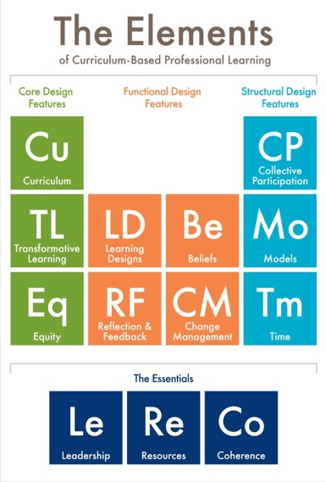
Protocol
2.1
What’s Next?
Post session — Read to reinforce: The Elements: Transforming Teaching and Curriculum-based Professional Learning (pp. 36–44)
Lesson 5 — Read to prepare Functional Elements (pp. 23–35)

Slide 15
Protocol
2.1
Additional Resources
Learning First Alliance Podcast 3: A Deep Dive into The Elements
Learning Forward Report: The Path to Instructional Excellence and Equitable Outcomes: D.C.’s LEAP program helps teachers become experts at teaching high-quality, standards-aligned content so that every student experiences rigorous and engaging instruction every day
Learning Forward Report: High-quality Curricula and Team-based Professional Learning: A Perfect Partnership for Equity (3 case studies)
Photo credits for Slides 2 and 8: Allison Shelley for EDUimages.
Notes:
NOTE: Same Resources in L6

