Slide 1
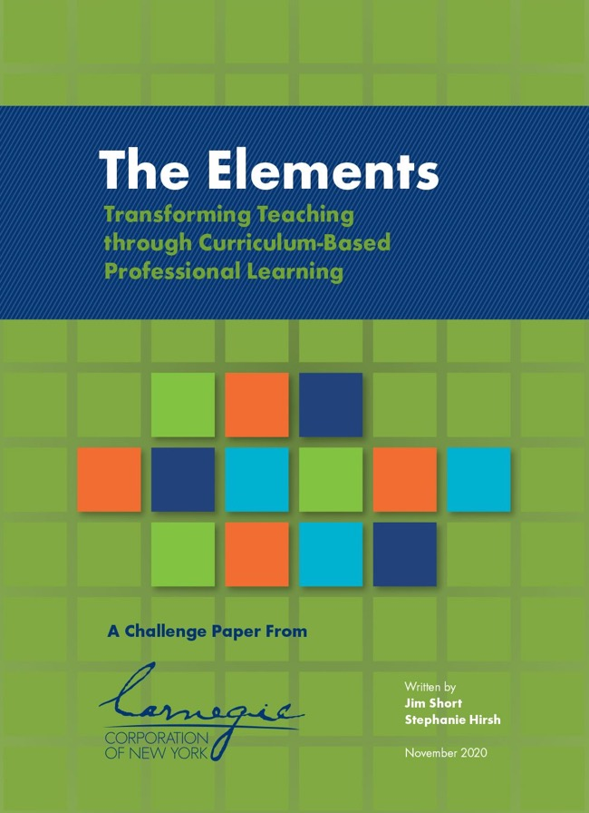
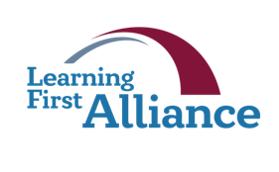
Lesson 3:
The Core Elements
Transforming Teaching: The Elements
Professional Learning Series
Developed by Stephanie Hirsh
This project is funded by the Carnegie Corporation of New York.
Download a copy of the report:
www.Carnegie.org/Elements

Slide 2
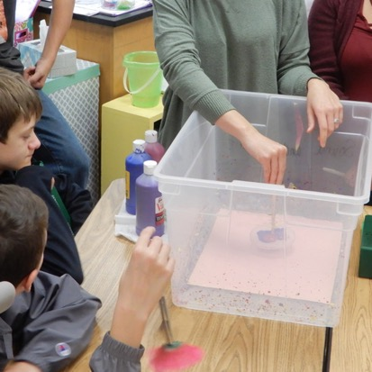
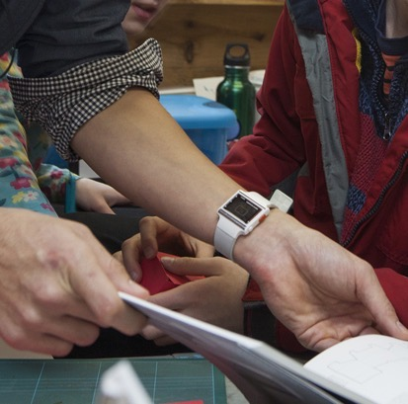
Lesson 3:
The Core Elements
From the story of curriculum-based professional learning, the research underlying it, and the framework supporting it, we invite you to learn more.
The next four lessons dive deeper into the framework. We begin with the Core design features that focus on the purpose of curriculum-based professional learning.
Curriculum-based professional learning focuses squarely on teacher understanding and application of high-quality instructional materials. With instructional materials at the center, teacher content and pedagogical content knowledge grows, practices and beliefs transform, and student learning soars.
For Lesson 3 you may choose to learn individually or with members of your learning team; instructions for both are included in the protocols.
And, as always, the Learning Journal offers you space to complete the protocols.

Slide 3
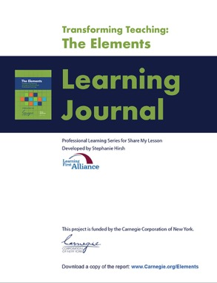
Lesson 3:
The Core Elements
Participants will:
Gain understanding of the Elements within the core design features.
Consider implications of the core Elements in action for their work.
Identify areas for further exploration.
To complete lesson protocols see pp. 16–18 in the Learning Journal.
Individuals
30 min.
•
Teams
45–60 min.
Recommended time for Lesson 3

Slide 4
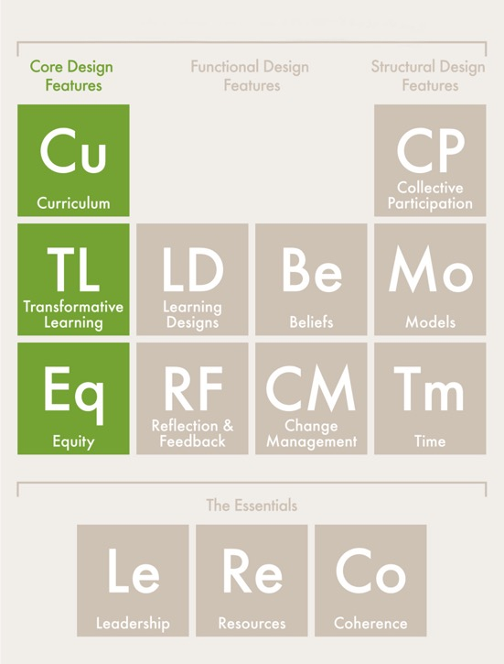
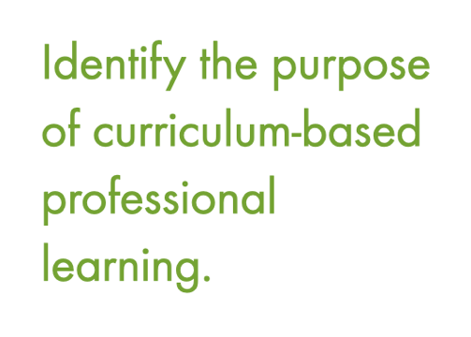
Core Design Features

Slide 5
Protocol
3.1
Where are you now?
Journal Writing
Refer to Protocol 3.1 in the Learning Journal (p. 16).
Reflect on these statements:
I am interested in learning more about what distinguishes the core design features…
I am wondering how much of my current professional learning focuses on the core Elements…
I am open to rethinking my priorities for professional learning...
I am committed to professional learning that will lead to the best outcomes for educators and students...

Slide 6
Protocol
2.1
Core Design Features
Builds teachers’ disciplinary content knowledge, pedagogical knowledge, and pedagogical content knowledge by using high-quality educative instructional materials.
Changes teachers’ deeply held beliefs, knowledge, and habits of practice through intentional design.
Articulates and advances high expectations for all students and applies culturally relevant pedagogies and content consistent with a shared vision for learning and teaching.

Slide 7
Protocol
3.2
Discovering Core Elements
Analyzing Video
Refer to Protocol 3.2 in the Learning Journal (p. 17).
1. Watch the Close Reading video and record examples for each core Element. (See the previous slide.)
2. Following the video, record any wonderings and questions you have in the Learning Journal.
3. Learning teams: Take turns sharing examples for each Element.
4. Learning teams: Finish the session by sharing a wondering or question.
Play
video.

Slide 8
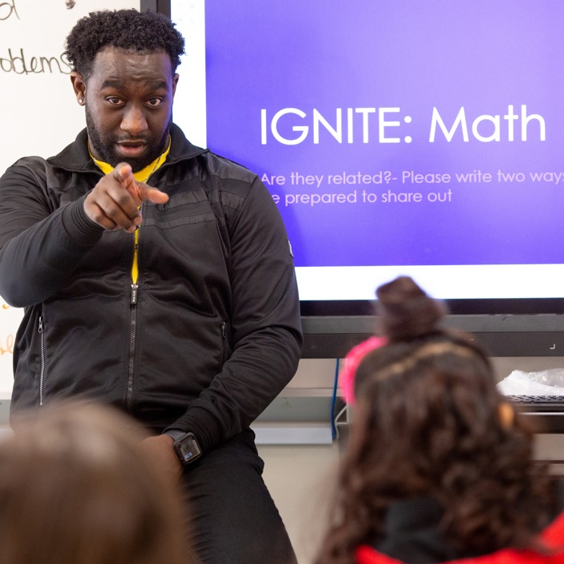
Protocol
3.3
Putting Core Elements to Work
Examing Your Practice
Refer to Protocol 3.3 in the Learning Journal (p. 17).
Study the next three slides:
Putting Curriculum to Work
Putting Transformative Learning to Work
Putting Equity to Work
Record actions that currently are routine in your own work and opportunities for expanding them in the Learning Journal.
Learning teams: Discuss your observations.

Slide 9
Protocol
2.1
Putting Curriculum to Work
From developer to engineer | Combine content and instructional expertise | Talking points, but not a script
Instead of thinking of standards as a starting point for developing their own lesson plans, teachers study and experience the underlying structures and internal logic in high-quality curriculum materials. After that learning experience, they can guide students through a well-designed sequence of learning. | Rather than focus on one aspect of a subject or on a particular instructional technique, curriculum-­based professional learning uses lessons directly from the curriculum to deepen teachers’ content knowledge. Teachers enhance their subject-matter expertise while practicing how to teach complex content to their students. | Developing fluency in a curriculum does not mean simply following it to the letter; teachers should still adjust their instruction to meet students’ needs. Educative materials and support can help teachers become comfortable conducting learning activities that keep students on track to meet ambitious goals. They help teachers anticipate likely challenges and prompt them to rehearse instruction with a range of student questions and discoveries in mind.

Slide 10
Protocol
2.1
Putting Transformative Learning to Work
Experiences, not speeches | Embrace discomfort | Flip the script
School districts spend thousands of dollars on motivational speakers with generic messages of inspiration, and most professional development takes the form of one-time seminars or presentations. Teachers, however, are active learners who construct their knowledge and beliefs based on direct experience. They need to experience curriculum and instruction and see how an approach benefits students rather than just hearing about it. | Active learning experiences that challenge teachers’ beliefs and assumptions enable new ideas and practices to take root. Learning experiences should highlight the disconnection between teachers’ long-held ideas and students’ abilities to engage with new curriculum and instruction. For example, some teachers may believe that they could harm their students by presenting rigorous content and complex activities. Observing a classroom of similar students successfully engaging in debate may dislodge such assumptions and build foundations for new instructional practices and ideas. | Assumptions are often unspoken and maintained by an unvarying point of view. Changing teachers’ vantage points can challenge their beliefs and promote change. Taking the student role in a lesson, for instance, provides teachers with hands-on experience and specific insights into how they can engage their students in standards­‑aligned activities.

Slide 11
Protocol
2.1
Putting Equity to Work
Reset high expectations for all | Scaffold, don’t simplify | Teacher–student relationships are key
Universal rigorous standards and expectations for what students can achieve must be at the forefront of curriculum selection processes, curriculum-based learning, and efforts to change classroom instruction and underlying assumptions — especially when it comes to the daily decisions that can accelerate or hinder student development. In particular, underprepared students need support, but they also need appropriately challenging, well-designed opportunities to struggle and grow. | Every student should have access to high-quality, demanding curriculum and opportunities to think critically. Every teacher should know how to scaffold learning experiences so that students are supported to engage with complex materials and activities. Promoting equity means avoiding strategies that leave underprepared students out of standards-aligned learning based on their current skill level. When teachers develop deep expertise in both content and curriculum, they can apply relevant tools and supports to ensure underprepared students complete challenging work. | Students are more likely to be engaged, have a positive outlook, bring their whole selves to school, and bring a positive mindset to their schoolwork when their relationships with teachers are strong. Teachers foster these connections by showing interest and confidence in students’ abilities and respect for their communities, families, and cultures. Knowledge gained through these relationships enables teachers to select culturally relevant content and learning experiences and ensure that discussion and meaning-making affirm all students’ identities.

Slide 12
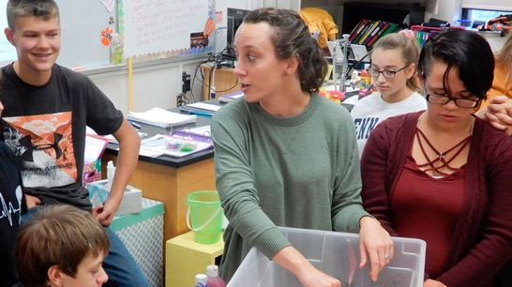
Protocol
3.4
Core Elements in Action
Directed Reading and Discussion
Refer to Protocol 3.4 in the Learning Journal (p. 18).
Read the story about Gladstone Elementary.
Use your new knowledge regarding the three core Elements to identify examples of each in action.
Record those examples in your Learning Journal.
Share your findings with your learning team.

Slide 13
Protocol
3.5
Final Reflections
Reflective Writing
Refer to Protocol 3.5 in the Learning Journal (p. 18).
In your Learning Journal, record important new learnings.
Identify conversations to have.
Identify new practices to try.
Record your next three actions and the time you want to allow yourself to achieve them.

Slide 14
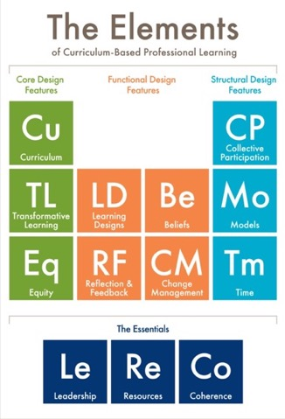
Protocol
2.1
What’s Next?
Post session — Read to reinforce: The Elements: Transforming Teaching and Curriculum-based Professional Learning (pp. 12–22)
Lesson 4 — Read to prepare: Structural Elements (pp. 36–44)

Slide 15
Protocol
2.1
Additional Resources
Carnegie Reporter, Spring 2021: How Curriculum-based Professional Learning Can Boost Student Outcomes
Learning First Alliance Podcast 3: A Deep Dive into The Elements
Learning Forward Journal, Summer 2022: The evolution of Standards for Professional Learning
Photo credits for Slides 2 and 8: Allison Shelley for EDUimages.

