Slide 1
Lesson 2:
Transformative Professional Learning
Transforming Teaching: The Elements
Professional Learning Series
Developed by Stephanie Hirsh
This project is funded by the Carnegie Corporation of New York.
Download a copy of the report:
www.Carnegie.org/Elements

Slide 2
Lesson 2:
Transformative Professional Learning
In this second lesson you will explore six differences between traditional and transformative professional learning.
Ideally, you already are experiencing the differences. Meanwhile, dig into these lessons to sample the kind of professional learning you may want to seek more of in your future.

Slide 3
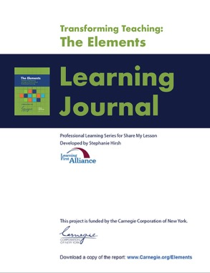
Lesson 2:
Transformative Professional Learning
Participants will:
Explore the differences, or shifts, between traditional and transformative professional learning.
Assess the degree to which their professional learning is transformative.
Consider implications of the recommended shifts for the professional learning they are responsible for planning or regularly experience.
To complete lesson protocols see pp. 9–15 in the Learning Journal.
Individuals
30 min.
•
Teams
45–60 min.
Recommended time for Lesson 2

Slide 4
Protocol
2.1
Where are you now?
Reflective Writing
Refer to Protocol 2.1 in the Learning Journal (p. 9).
Reflect on these statements:
I am wondering how curriculum-based professional learning differs from other types of professional learning…
I am curious about the shifts required to move toward curriculum-based professional learning…
I am interested in learning more about the changing emphases involved in curriculum-based professional learning…
I am committed to professional learning that helps improve teachers’ practices and leads to better student outcomes…

Slide 5
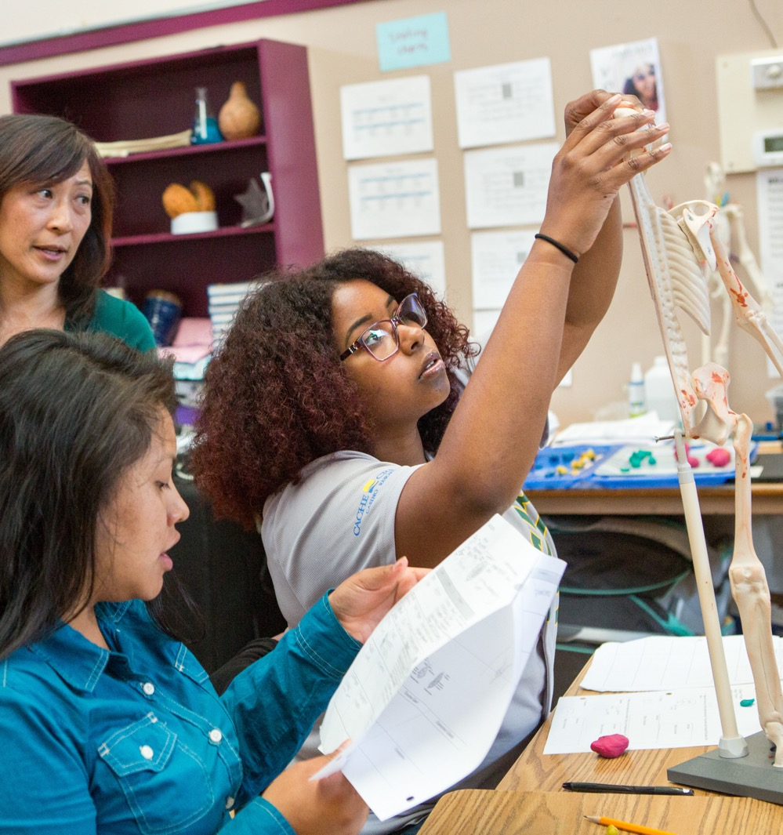
Protocol
2.2
Transformative Teaching
Journal Writing
Refer to Protocol 2.2 in the Learning Journal (p. 10).
What do you remember about your middle school science experience? Think about the role of the teacher and your role as student. Record your thoughts in the Learning Journal.

Slide 6
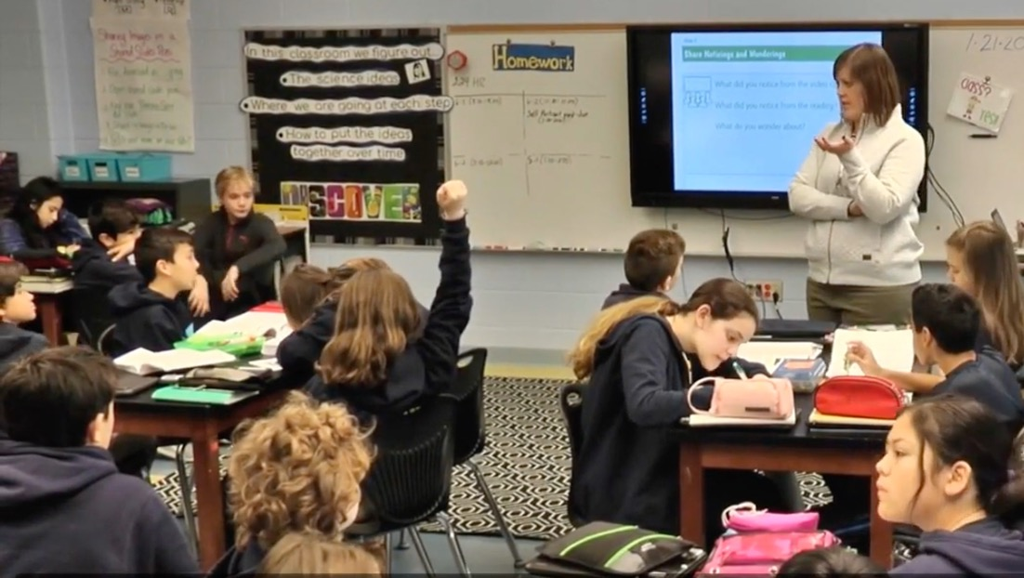
Protocol
2.3
Transformative Teaching
Video Analysis
Refer to Protocol 2.3 in the Learning Journal (p. 10).
Watch the OpenSciEd video.
During the video note what the students are doing and what the teacher is doing.
After watching the video answer the questions in the Learning Journal.
With a partner or your learning team, share a highlight from your responses.
Play
video.

Slide 7
Protocol
2.4
Transformative Professional Learning
Examining Assumptions
Refer to Protocol 2.4 in the Learning Journal (p. 11).
My Assumption: | Few teachers were initially prepared to teach using the learning approaches contained in new, high-quality educative instructional materials.
My Assumption: | Teachers will appreciate and benefit from professional learning that allows them to experience these new approaches as a “student learner” before implementing them in their classroom.
This approach to curriculum-based professional learning is challenging to design and facilitate. It requires substantive shifts in the ways we approach professional learning.
What do you think? Record your thoughts in your Learning Journal.

Slide 8
Protocol
2.5
Curriculum-based Professional Learning Shifts
Inventorying Current Practice
Refer to Protocol 2.5 in the Learning Journal (p. 11–15).
First, review Slides 9–14. Then . . .
Consider where your current and desired practices are in relation to each shift.
Select a minimum of three shifts to dig deeper.
Complete the inventory in the Learning Journal (pp. 12–15) for these shifts.
Share desired responses with members of your learning team.

Slide 9
Protocol
2.5
Curriculum-based Professional Learning Shifts
Inventorying Current Practice, continued
Table 2.1: From Curriculum Developer to Learning Facilitator
Less Emphasis On | More Emphasis On
Teacher as curriculum developer | Teacher as learning facilitator using high-quality instructional materials to support student learning
Old curriculum realigned to new standards | Newly developed educative instructional materials that help teachers develop content knowledge and pedagogical content knowledge
Scripted curriculum | Educative curriculum that guides effective implementation and provides annotated support for meeting needs of individual learners
Professional learning that focuses on deepening teachers’ content knowledge and asking them to apply it to their teaching | Professional learning grounded in using high-quality instructional materials that simultaneously deepen teacher knowledge of content and how to teach that content to students

Slide 10
Protocol
2.5
Curriculum-based Professional Learning Shifts
Inventorying Current Practice, continued
Table 2.2: From Disconnected Learning to Deep Dives Into High-quality Curriculum
Less Emphasis On | More Emphasis On
Curriculum orientation sessions that present information about new instructional materials to teachers | Professional learning sessions that provide opportunities to experience new instructional materials as “student” learners
Professional development activities disconnected from the curriculum | Curriculum-anchored professional learning with intentional opportunities to reflect on beliefs about learning and teaching
Training sessions that emphasize solely building teacher content knowledge | Facilitated conversations that address the connection between thinking and learning

Slide 11
Protocol
2.5
Curriculum-based Professional Learning Shifts
Inventorying Current Practice, continued
Table 2.3: Less Adapting and More Scaffolding
Less Emphasis On | More Emphasis On
Lowering expectations and compromising the rigor of instructional materials for selected students | Raising expectations for all students by scaffolding instructional materials appropriately to ensure all students engage with rigorous content
Adapting instructional materials based on perception of students’ abilities | Adapting instructional materials to meet the needs of students while maintaining the integrity of the materials

Slide 12
Protocol
2.5
Curriculum-based Professional Learning Shifts
Inventorying Current Practice, continued
Table 2.4: From Fragmentation to Coherence
Less Emphasis On | More Emphasis On
Instructional vision development reserved for select groups of individuals | Broad-based leadership representation on development and implementation of instructional vision
School systems attempting to implement multiple initiatives to improve curriculum, instruction, and assessment | School systems focusing instructional improvement efforts on curriculum implementation and curriculum-based professional learning
Curriculum procurement and professional learning services purchase decisions siloed from other district decisions | Curriculum and professional learning services purchase decisions aligned with instructional vision and plans for realizing it

Slide 13
Protocol
2.5
Curriculum-based Professional Learning Shifts
Inventorying Current Practice, continued
Table 2.5: From Retrofitting to Establishing New Structures
Less Emphasis On | More Emphasis On
Collaborative groups organized by choice | Collaborative groups organized by grade levels and subjects using the same core curriculum
Using collaborative learning structures and professional learning communities to address several priorities | Protecting professional learning community time for implementing new instructional materials
All professional learning opportunities focusing attention on early-use models | Professional learning opportunities distributed across models that address early use, ongoing support, and capacity building
Curriculum-based professional learning limited to curriculum orientations and/or summer sessions | Curriculum-based professional learning that spans the entire year

Slide 14
Protocol
2.5
Curriculum-based Professional Learning Shifts
Inventorying Current Practice, continued
Table 2.6: Shifts in How Professional Learning is Designed and Implemented
Less Emphasis On | More Emphasis On
One-size-fits-all approach to planning professional learning support for the use of new instructional materials | Different learning designs that support teachers at different stages of implementation using new instructional materials
Feedback and reflective practices used solely during the monitoring and assessment phases of the learning cycle | Feedback and reflective practices embedded in every phase of the teacher learning cycles
Change as an event that treats everyone involved the same | Change as a process that occurs over time and uses individualized support to accelerate implementation

Slide 15
Protocol
2.6
Curriculum-based Professional Learning Shifts in Action
Reading and Reflecting
Refer to Protocol 2.6 in the Learning Journal (p. 15).
Select one of these cases to read in Practice What You Teach:
District of Columbia Public Schools LEAP Into School-based Professional Learning (p. 7–9) OR
Teaching Lab in West Virginia: Grassroots Take Hold in the Mountain State (p. 9–11)
Identify examples of the shifts in action.
Reflect on what you want to learn and/or do next.
Complete the table in the Learning Journal.
Share your findings as appropriate with members of your learning team, a colleague, or a coach.

Slide 16
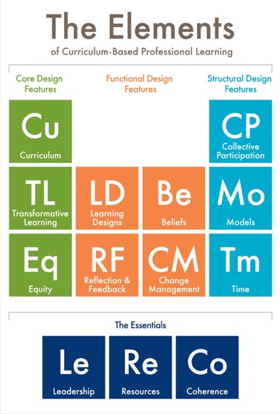
Protocol
2.1
What’s Next?
Post session — Read to reinforce: The Elements: Transforming Teaching and Curriculum-based Professional Learning (pp. 4–11)
Lesson 3 — Read to prepare: Core Design Features (pp. 12–22)

Slide 17
Protocol
2.1
Additional Resources
Learning First Alliance Podcast 2: Leveraging The Elements
OpenSciEd Professional Development Resources:
Facilitator PD Videos
Professional Learning for Teachers
Learning Forward Revised Standards for Professional Learning
Photo credits for Slides 2 and 5: Allison Shelley for EDUimages.

