Slide 1
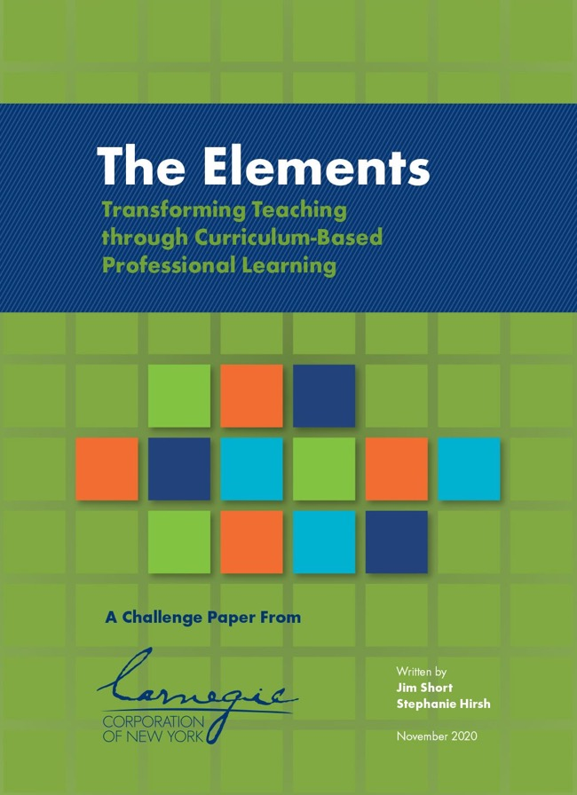
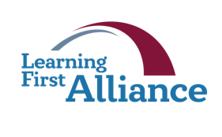
Lesson 1:
The Elements
Transforming Teaching: The Elements
Professional Learning Series
Developed by Stephanie Hirsh
This project is funded by the Carnegie Corporation of New York.
Download a copy of the report:
www.Carnegie.org/Elements

Slide 2
Lesson 1:
The Elements
Welcome!
In this first lesson you will explore the research and foundation for the Elements. The Elements are a core set of actions, approaches, and enabling conditions that effective schools and systems enact or create to reinforce and amplify the power of high-quality curriculum and skillful teaching.
These sessions introduce teachers to an approach to professional learning designed to mirror the experiences they want their students to have in the classroom.

Slide 3
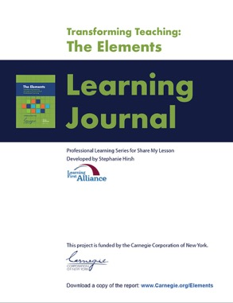
Lesson 1:
The Elements
Participants will:
Increase knowledge of research findings related to instructional materials and professional learning.
Apply such findings to the design and implementation of professional learning.
Learn the foundation for the Elements framework and consider implications for their work.
To complete lesson protocols see pp. 5–8 in the Learning Journal.
Individuals
30 min.
•
Teams
45–60 min.
Recommended time for Lesson 1

Slide 4
Protocol
1.1
Where Are You Now?
Reflective Writing
Refer to Protocol 1.1 in the Learning Journal (p. 5).
Why do high-quality instructional materials and professional learning matter?
Record your thoughts in the Learning Journal.

Slide 5
Protocol
2.1
“Increases in student learning occur only as a consequence of improvements in the level of content, teachers’ knowledge and skill, and student engagement.”
— Richard Elmore
In this quote Elmore defines the three parts of the “instructional core.” Our work together focuses on your efforts to strengthen and balance that instructional core.
Teacher’s knowledge & skills Professional Learning
Level of students’ active learning Instructional Materials
Level of content Standards & Assessment
Richard F. Elmore, Bridging the Gap Between Standards and Achievement (Washington, DC: Albert Shanker Institute, 2002).

Slide 6
Protocol
1.2
What Research Says
Read and Reflect
Refer to Protocol 1.2 in the Learning Journal (p. 6).
Use the key questions in the Learning Journal to guide your study. Below are some of the most relevant and recent research findings related to the role of instructional materials and professional learning in influencing teacher practice and student learning. References for each finding are included in the Learning Journal (p. 6).
Most professional development rarely achieves substantial positive impacts on teacher performance or student outcomes.
A broad gap exists between the short-term, isolated experiences that typify professional development and the ongoing, content-focused, job-embedded professional learning that can help teachers and their students excel.
Continued

Slide 7
Protocol
1.2
What Research Says
Read and Reflect, continued
3. Even when learning is focused on a particular content area, it tends to be short-lived, with most teachers participating in no more than 16 hours of activities — on the order of a seminar or two — in a year.
4. Just 7 percent of the nation’s elementary school reading teachers use at least one standards-aligned instructional tool in classroom instruction.
5. More than half of U.S. teachers craft curriculum for their students, either by borrowing from multiple sources or by creating their own materials.
6. When teachers participated in curriculum-based professional learning, their students’ test scores improved by 9 percent of a standard deviation — about the same effect caused by replacing an average teacher with a top performer or reducing class size by 15 percent.

Slide 8
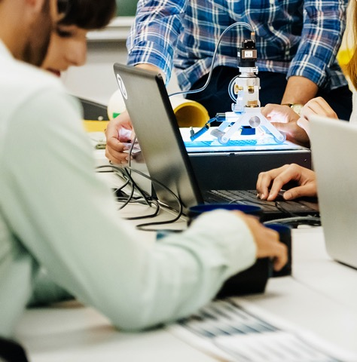
Protocol
2.1
The implications are clear. Curriculum matters, and how teachers use curriculum can matter even more.

Slide 9
Protocol
1.3
Key Terms
Review and Distinguish
Refer to Protocol 1.3 in the Learning Journal (p. 7).
Review the following key terms, which will be used throughout the lessons. Look for what is familiar and what is new to you. Record your learning in the Learning Journal.
A curriculum is the design teachers use to plan, implement, and assess the learning outcomes for students.
A high-quality curriculum includes standards-aligned instructional materials that teachers use, as well as resources that states and districts provide to support instruction such as state standards, frameworks, scope and sequences, district instructional guidance, and interim assessments.
Instructional materials and curriculum materials refer to the tangible resources that teachers use to provide standards-aligned learning experiences for students, as well as those that offer support and guidance for teachers on how to teach the materials.
Continued

Slide 10
Protocol
1.3
Key Terms
Review and Distinguish, continued
High-quality instructional materials and curriculum materials include specific learning goals with unit plans and sets of detailed lessons aligned to content standards, student-centered approaches to inquiry-based learning, research-based teaching strategies, teacher support materials, and embedded formative assessments. Such materials help teachers effectively implement coherent instructional units and courses organized around a clear scope and sequence.
When high-quality instructional and curriculum materials support both student and teacher learning, they are considered educative curriculum materials.
Professional learning focused on supporting the implementation of high-quality instructional materials is curriculum-based professional learning.

Slide 11
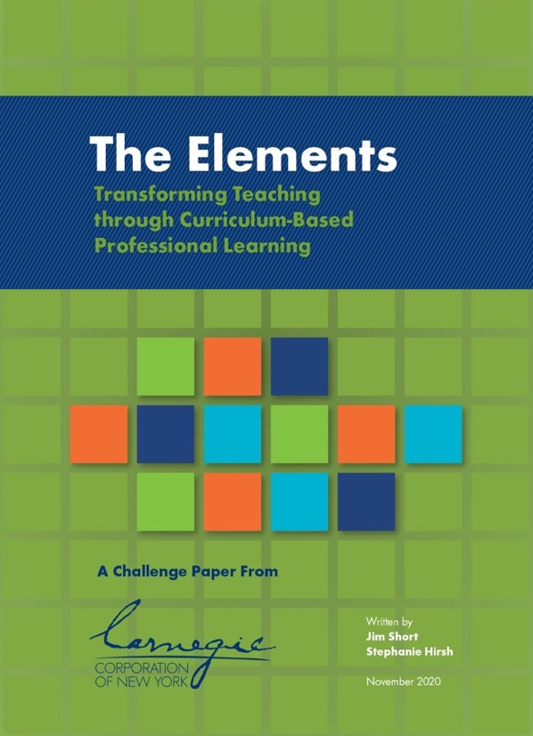
Protocol
2.1
What is The Elements?
A Challenge Paper from Carnegie Corporation of New York, The Elements explores how professional learning anchored in high-quality curriculum materials can allow teachers to experience the instruction that their students will, change instructional practices, and lead to better student outcomes.
Explore and download a copy of the report:
www.Carnegie.org/Elements

Slide 12
Protocol
2.1
In addition to taking a deep dive into the research base, the following organizations and school systems contributed to the report.
Carnegie Corporation of New York Grantees:
Teachers and System Leaders:
Baltimore City Schools, Maryland
Boston Public Schools, Massachusetts
Caldwell Parish School District, Louisiana
Charlotte-Mecklenburg Schools, North Carolina
D.C. Public Schools
Lafayette Parish School System, Louisiana
Lawrence Public Schools, Kansas City, Missouri
Sullivan County Schools, Tennessee
Sunnyside Unified School District, Tucson, Arizona

Slide 13
Protocol
1.4
The Elements
Identifying the Elements
Refer to Protocol 1.4 in the Learning Journal (pp. 7–8).
Reflect on your previous experiences with curriculum-based professional learning. What contributed to its success?
Watch the video and makes notes as elements are introduced to you.
Check which elements were consistent with your previous experiences.
Check which elements were new to you.
Share an observation with your learning team.
Play
video.
Notes:
These are SH instructions in the Learning Journal:
• Watch the video and make notes while the Elements are introduced to you.
• Reflect on all your experiences related to selecting and implementing new curricular material.
• Consider the immediate and long-term support for implementation.
• What do you anticipate will be included among the Elements?
• Make a list using the table on the following page.
• Record additional thoughts to support your learning.
And these are instructions that were on SH draft of Protocol 1.4 in the PP. They were written as a paragraph:
Refer to Protocol 1.4 in the Learning Journal. Reflect on all your experiences related to selecting and implementing new curricular materials. Consider the immediate and long-term support for implementation. What do you anticipate will be included among the Elements? Then watch the video on the next slide and see how many Elements you successfully identified.

Slide 14
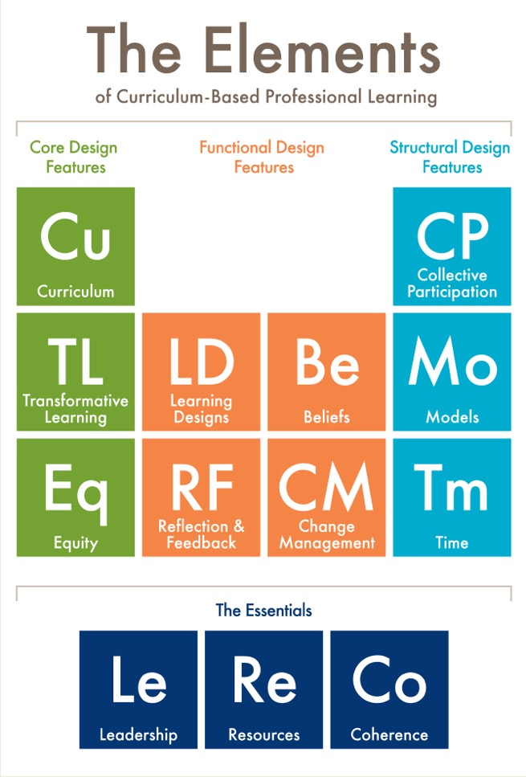
Protocol
2.1
The Elements
A core set of actions, approaches, and enabling conditions grounded in research and evidence that effective schools and systems put into place to reinforce and amplify the power of high-quality curriculum and skillful teaching.

Slide 15
Protocol
2.1
It’s a simple concept.
Teachers experience the same kind of inquiry-based learning that they want their students to experience.
But is it that simple to do? This shift is what we will explore over the next six lessons.

Slide 16
Protocol
1.5
The Elements
Thinking Forward
Refer to Protocol 1.5 in the Learning Journal (p. 8).
Use the protocol to capture your key learnings and reflections from this introductory lesson and plan your next actions.

Slide 17
Protocol
2.1
What’s Next?
Post session — Read to reinforce: The Elements: Transforming Teaching and Curriculum-based Professional Learning (pp. 4–11)
Lesson 2 — Read to prepare: Transformative Professional Learning (pp. 5–9)

Slide 18
Protocol
2.1
Additional Resources
Carnegie Reporter, Spring 2021: How Curriculum-based Professional Learning Can Boost Student Outcomes
Learning First Alliance Podcast 1: Introduction to The Elements
Explore EdReports.org and specifically Why Materials Matter
See Twitter @HirshLF #CurriculumPL
Photo credits, Slides 2, 8, 15, and 16: Getty Images.

